Slide 1
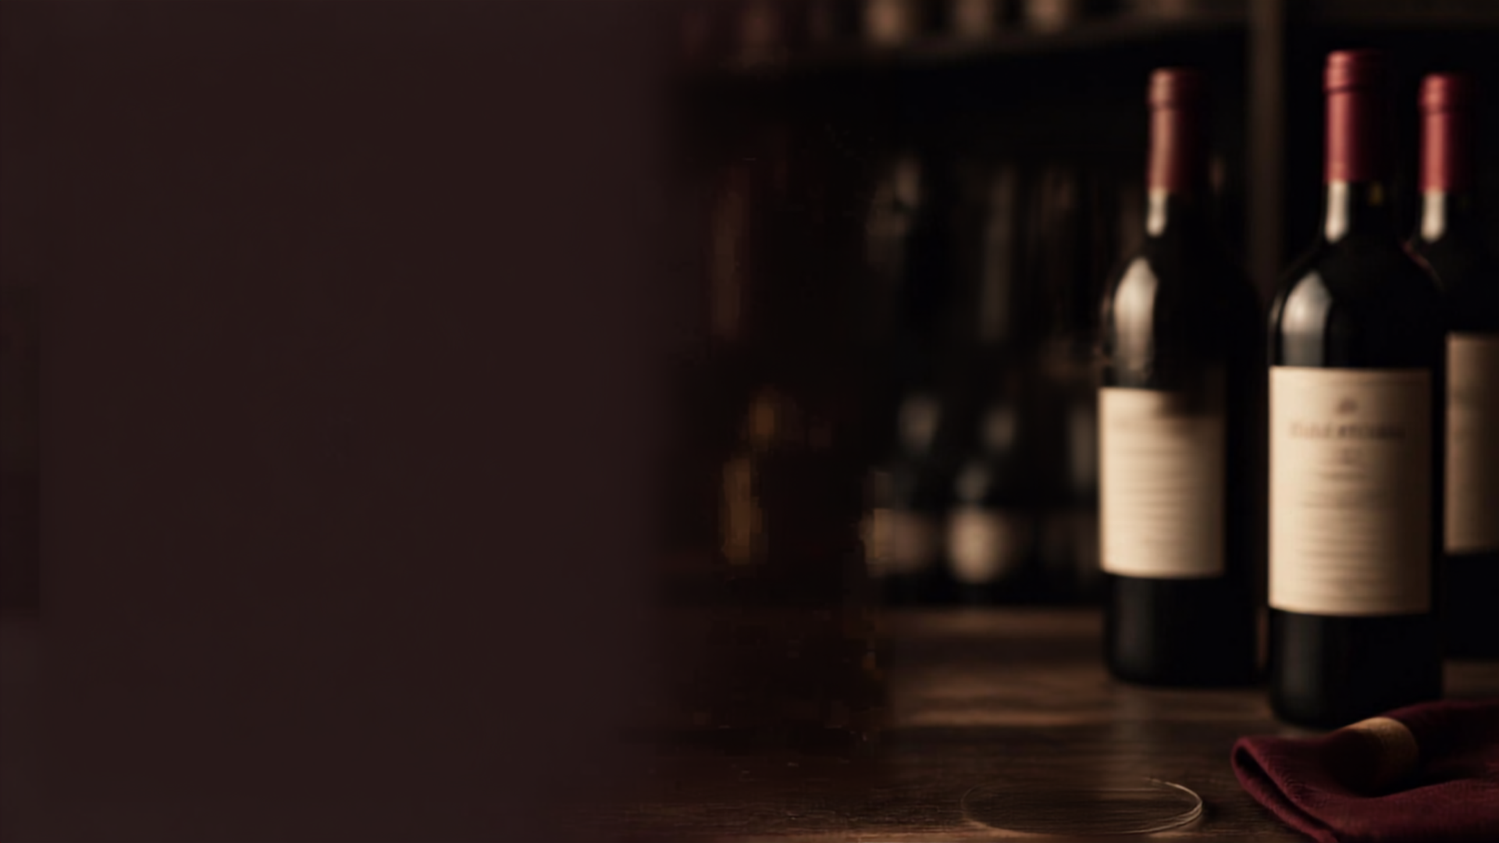
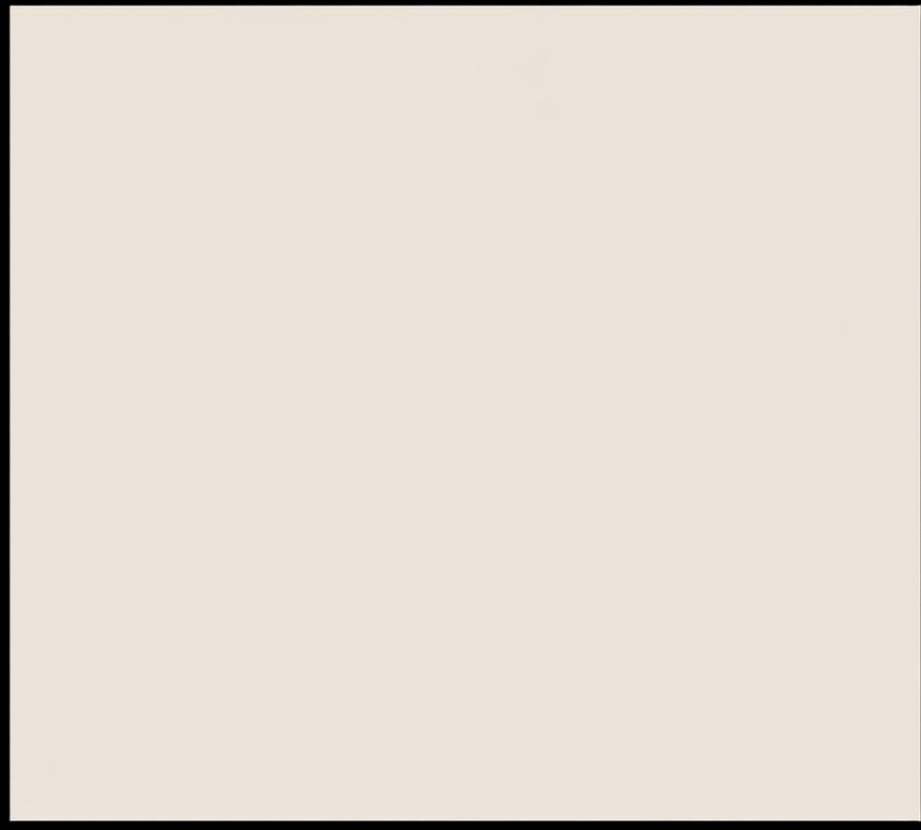


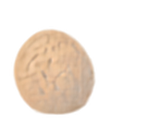
Feature Importance Analysis For Wine Quality Using Random Forest
TEAM MEMBER:
Roll No. 2520030609

Slide 2


Introduction
Wine quality is traditionally assessed by expert tasters
This process is slow, costly, and can be inconsistent
Machine learning can uncover patterns in chemical properties
Predict wine quality more efficiently with data-driven models

Slide 3
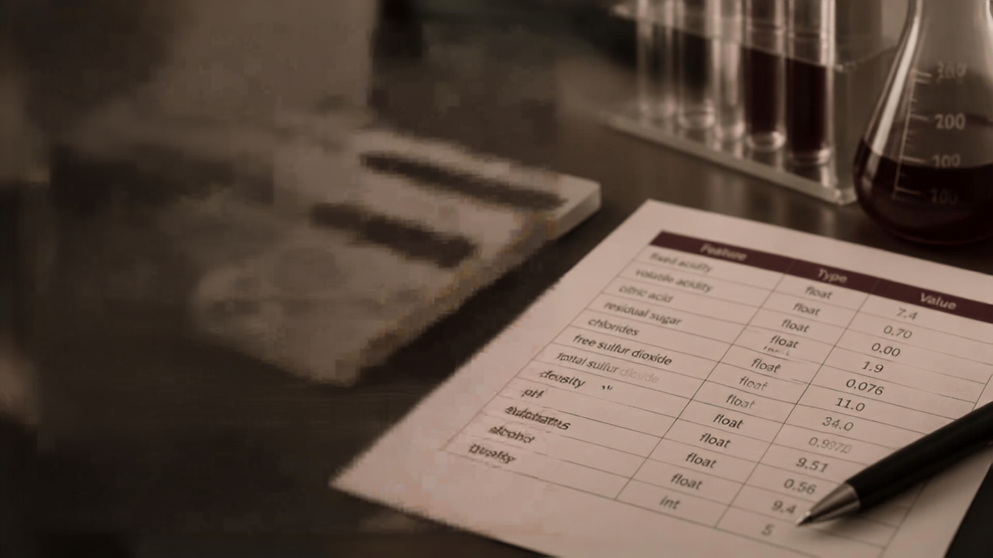

Abstract
Predict red wine quality from chemical measurements
Identify the features that drive quality predictions
Use Random Forest to combine many decision trees and reduce bias

Slide 4




Existing System
Wine quality is judged by human senses such as smell, taste, and appearance
This process is time-consuming and costly
Results vary between people and are hard to reproduce
Struggles to keep up with large volumes of data

Slide 5



Proposed System
Prepare and clean the wine quality dataset
Separate chemical properties from quality scores
Train Random Forest model
Predict wine quality
Calculate feature importance
Present results clearly

Slide 6
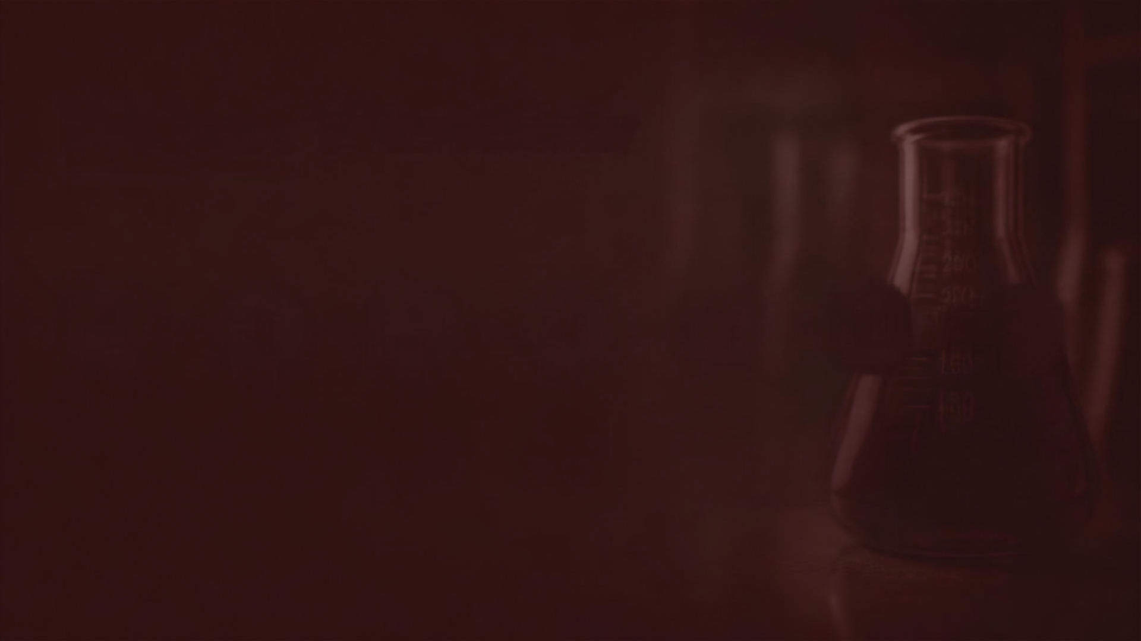

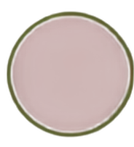

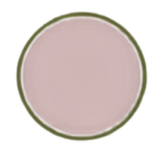

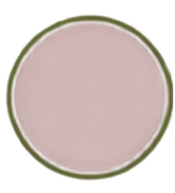







Project Workflow
1
2
3
4
5
6
7
Wine Quality Dataset
Data Cleaning / Preparation
Split Features & Target
Train Random Forest
Predict Quality
Calculate Feature Importance
Show Insights

Slide 7
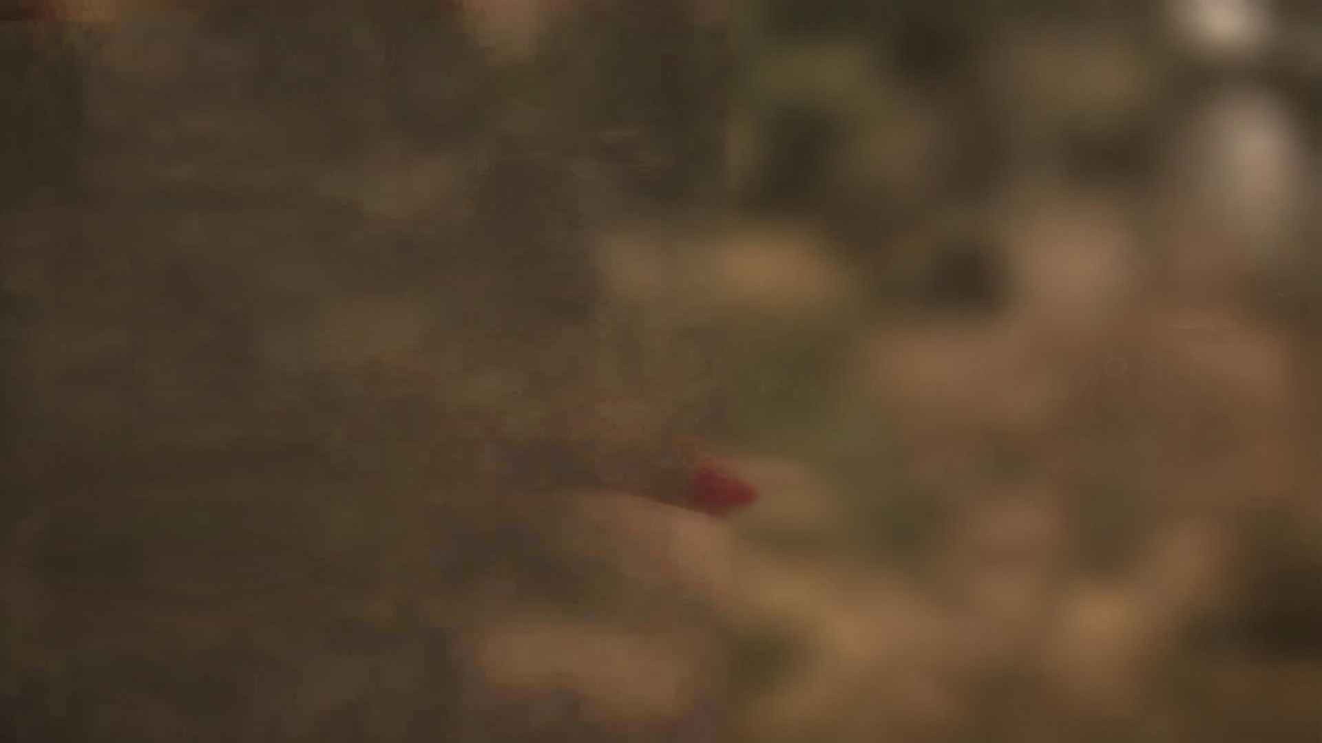

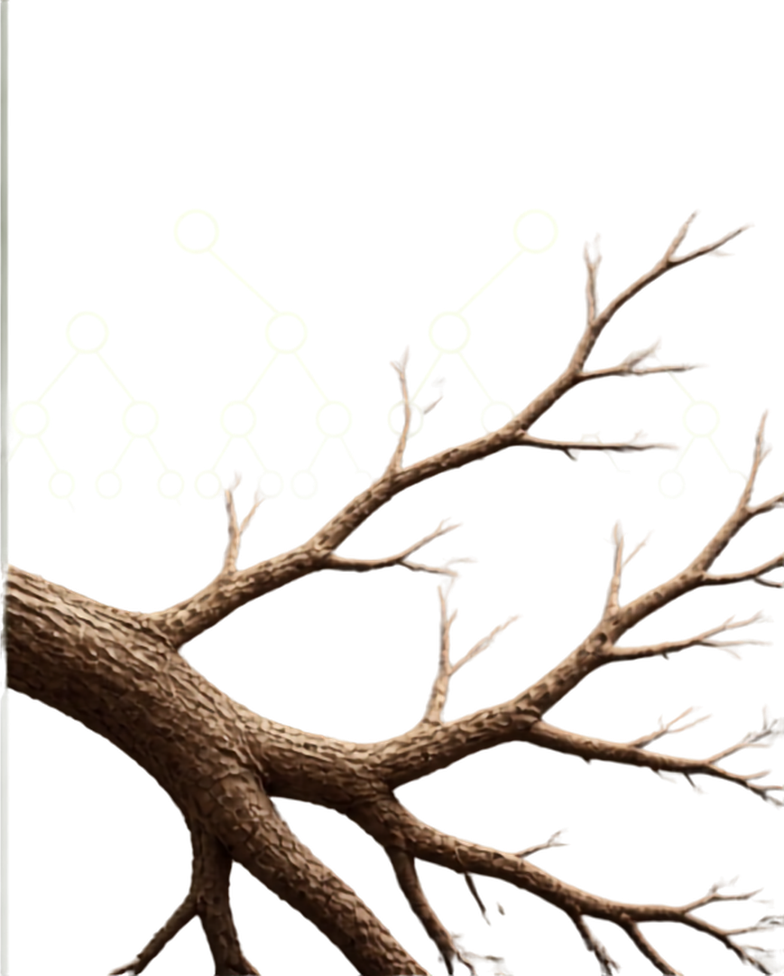

Algorithms Used
Random Forest
Uses many decision trees together to predict wine quality.
Decision Tree
Makes decisions by splitting the data based on different features
Feature Importance
Shows which wine properties are most important for predicting quality.
Supporting Steps
The data is divided into training and testing sets, and the model is checked using performance measures.

Slide 8
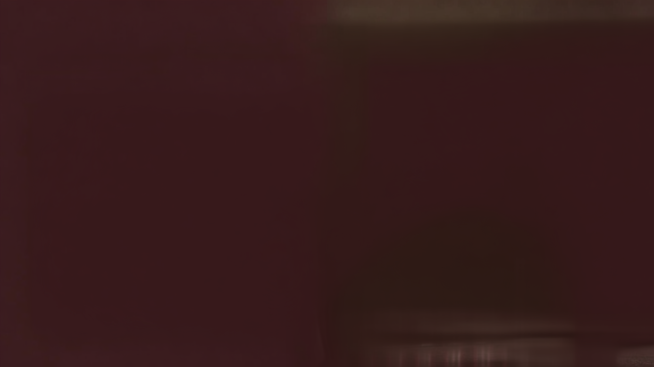
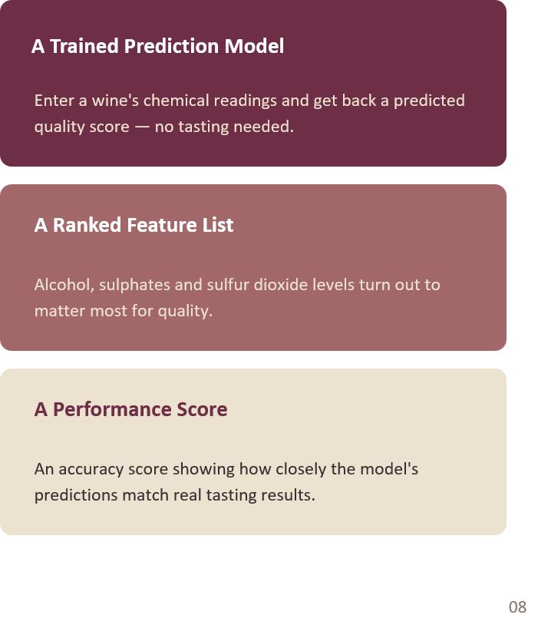
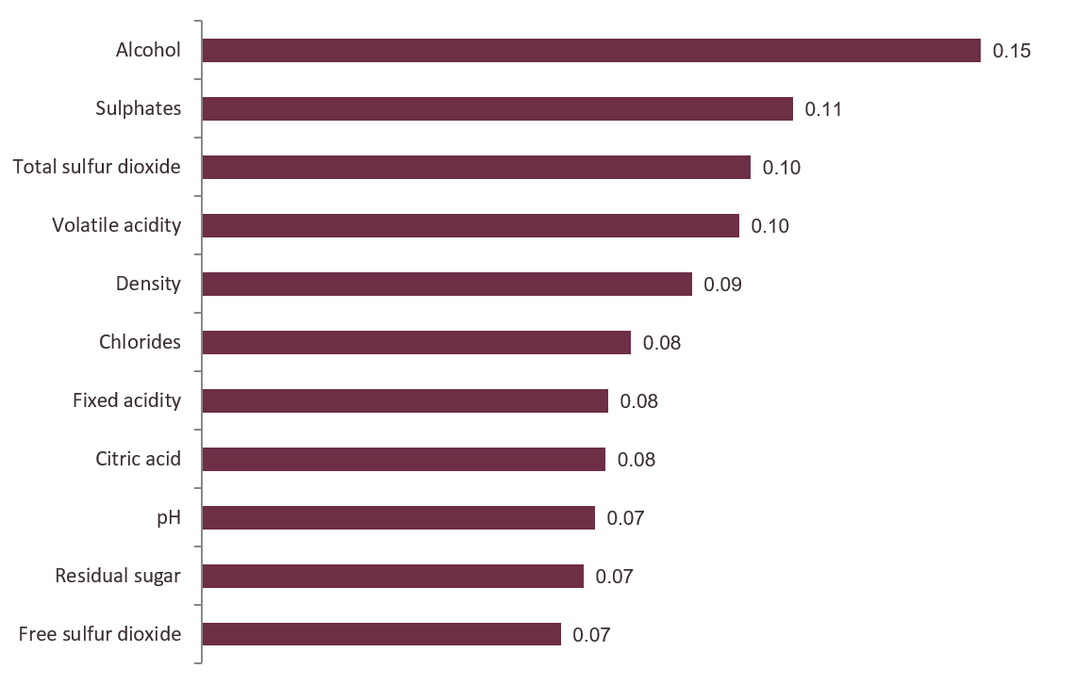
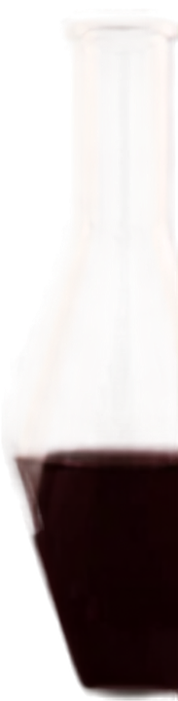
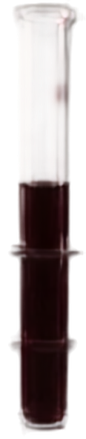

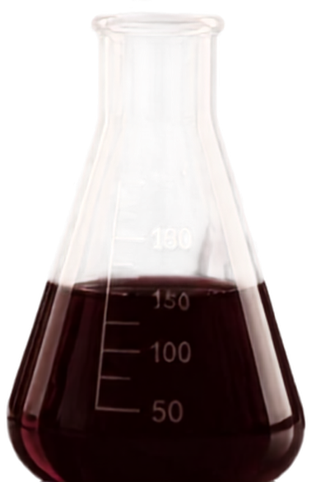
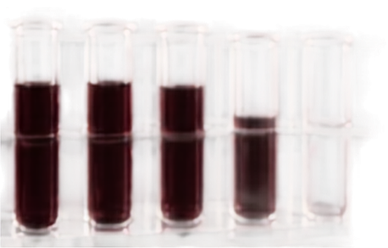
Expected Output
Which chemical property affects wine quality the most?

Slide 9

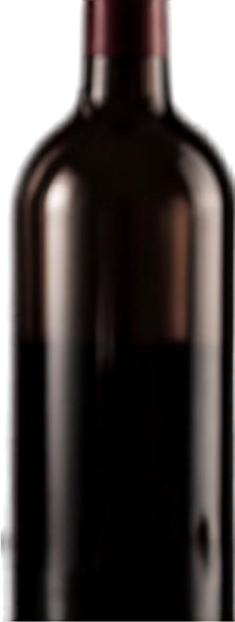
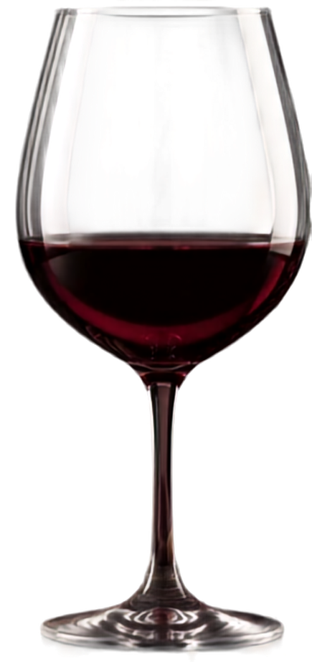
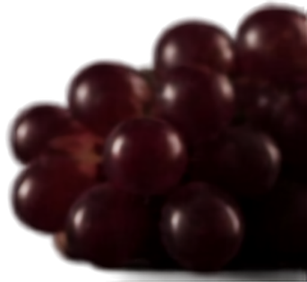
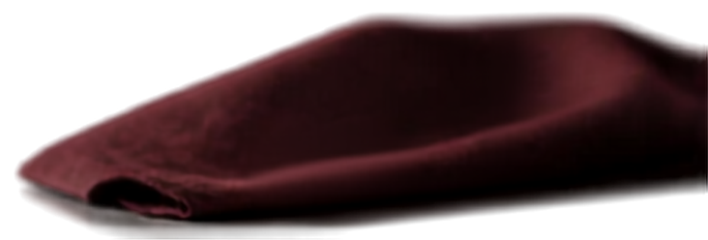
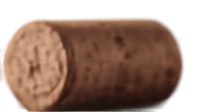
Thank You!

